Slide 1


Tech अभिव्यक्ति
Team Details:
Shivansh Sharma
2210990832
Shiven Narang
2210990835
Sneha Pal
2210990996
Mentor Name:
Dr. Sunil Gupta
A Project Expo by CSE 2022 Batch at Chitkara university
A Tech Track Series Initiative by OPEN SOURCE CHANDIGARH

Slide 2
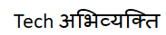

Introduction
TO MAKE OUR RESOURCES RESERVED AND TO SAVE TIME
Needs a lot of paper work
Problem with maintenance
Volumes of data becomes problem
Once data is burned it cannot be reproduced easily
Data handling is problem

Slide 3
PROBLEM STATEMENT
The problem with traditional hospital management systems is that they are often manual, paper-based, and disjointed, making it difficult to efficiently manage patient information, resources, and processes. This can lead to increased costs, decreased productivity, poor patient experiences, and even medical errors.
The current hospital management systems often face challenges such as manual processes, fragmented information, and limited integration with other systems, leading to inefficiencies and increased costs. These issues can result in decreased patient satisfaction, errors in medical care, and reduced productivity.

Slide 4
SOLUTION
The goal of a hospital management system is to streamline hospital operations and provide real-time access to relevant information for all stakeholders, including patients, physicians, nurses, administrators, and billing staff. This system should be able to automate and manage the following processes:
Patient Registration
Patient Management
Appointments
Specializations
A hospital management system should be secure, reliable, user-friendly, and able to integrate with other systems used in the hospital. By implementing a comprehensive hospital management system, healthcare organizations can improve patient outcomes, reduce costs, and enhance the overall efficiency of their operations.

Slide 5

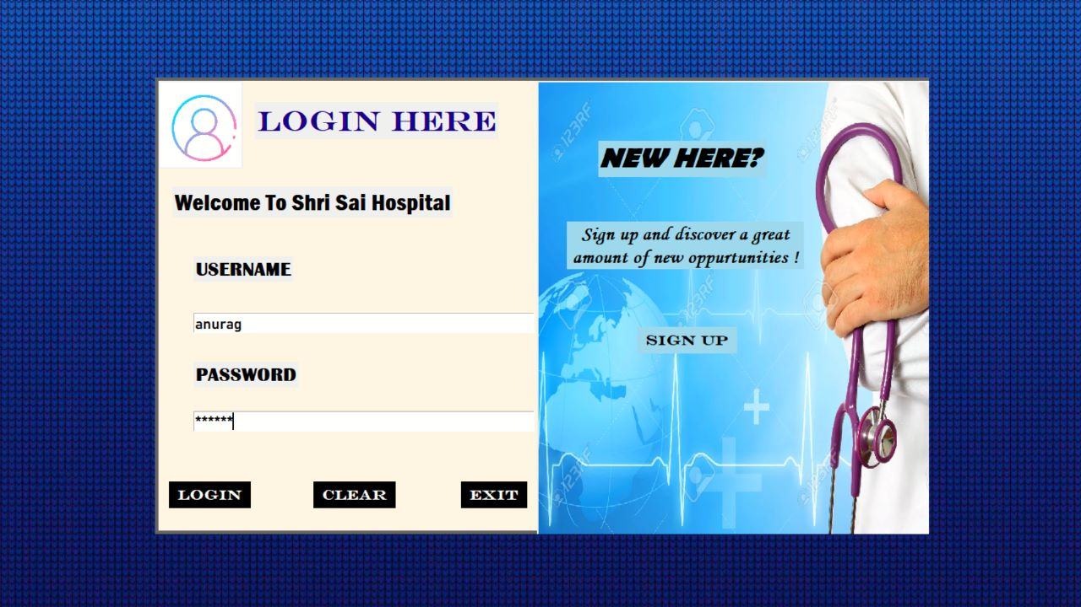
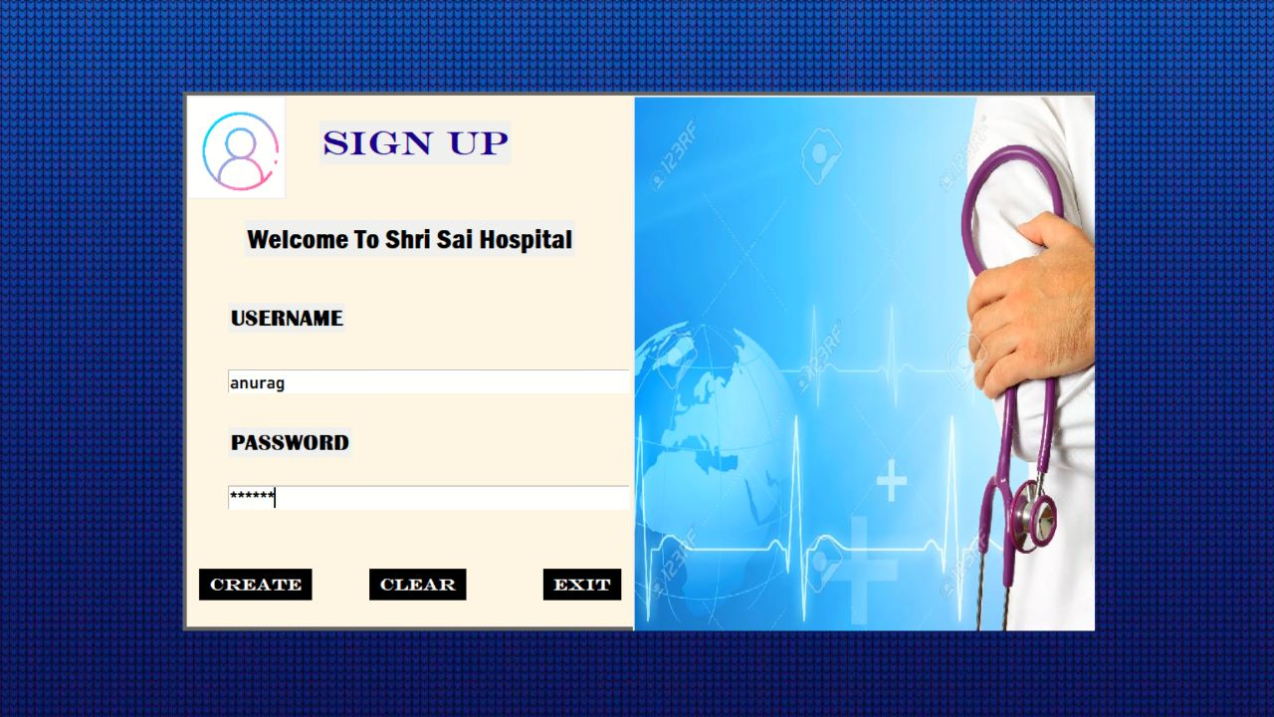
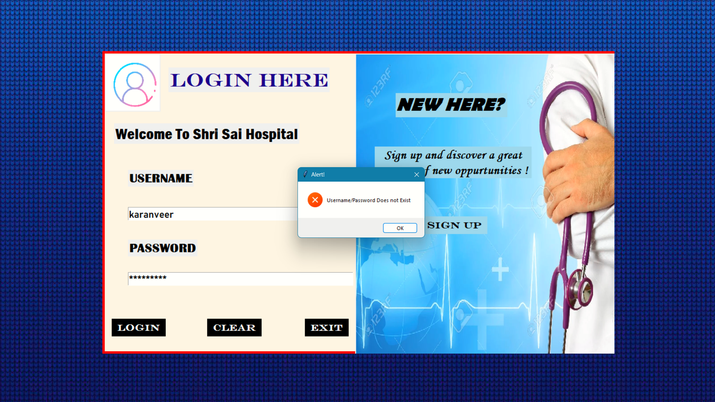
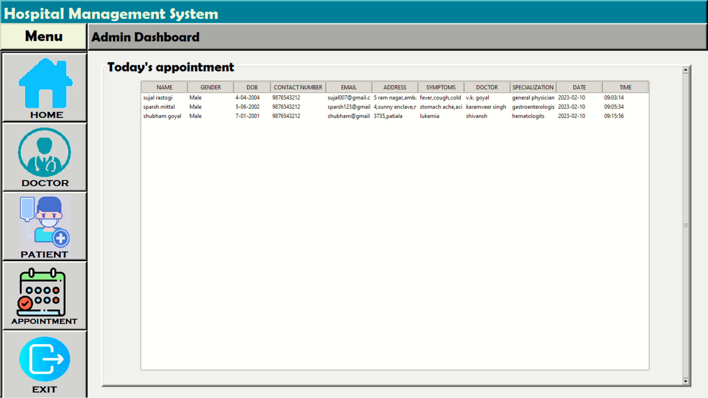
IMPLEMENTATION
If user Doesn’t Sign up

Slide 6
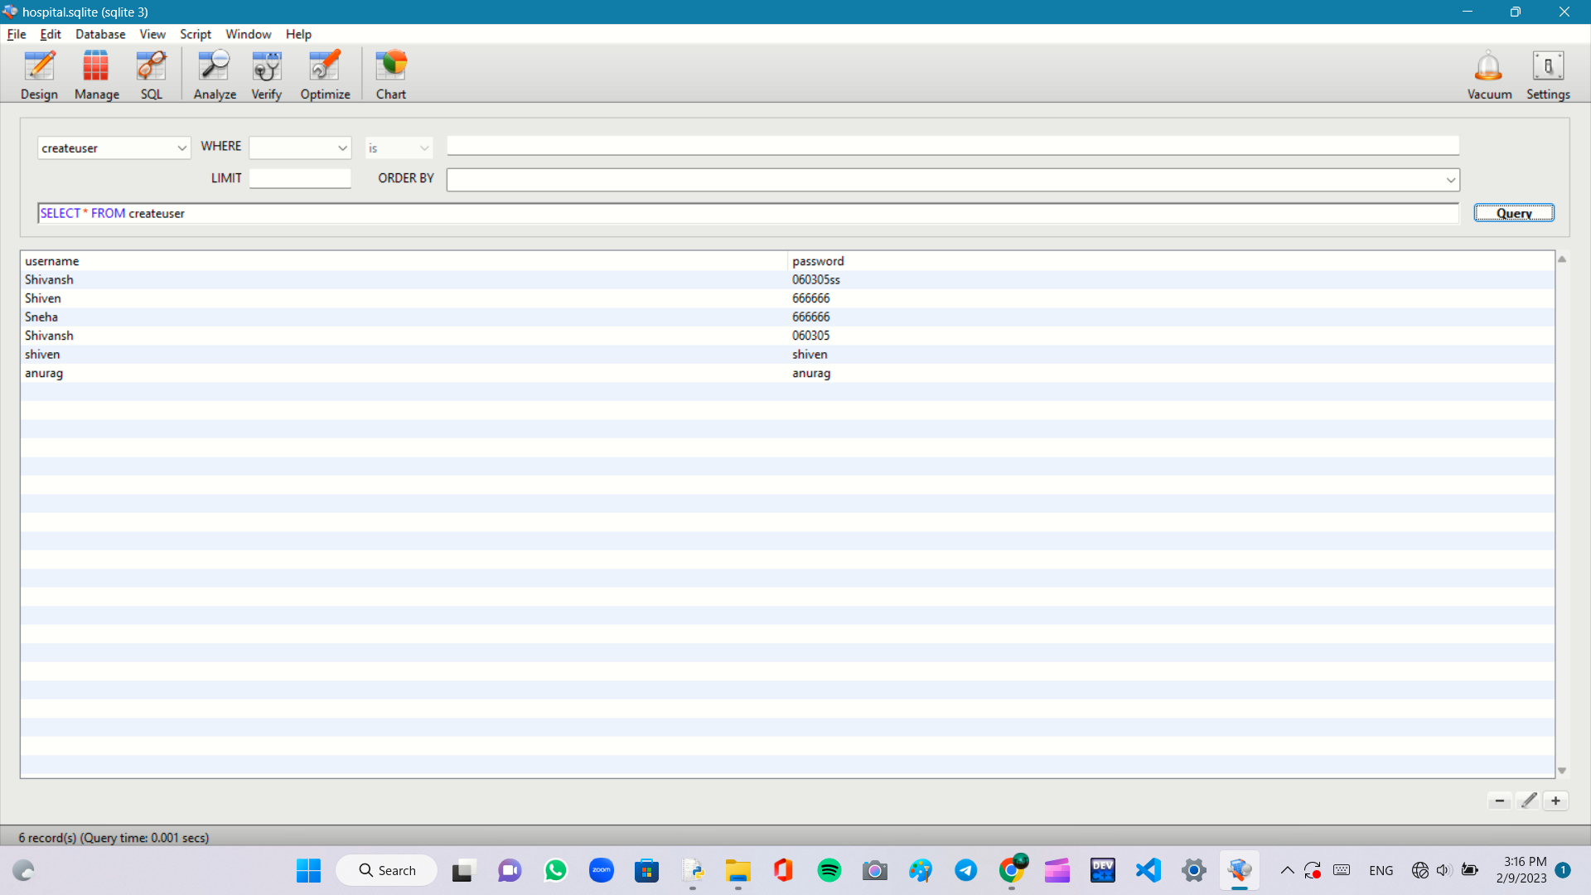
DATABASE OF CREATE USER

Slide 7
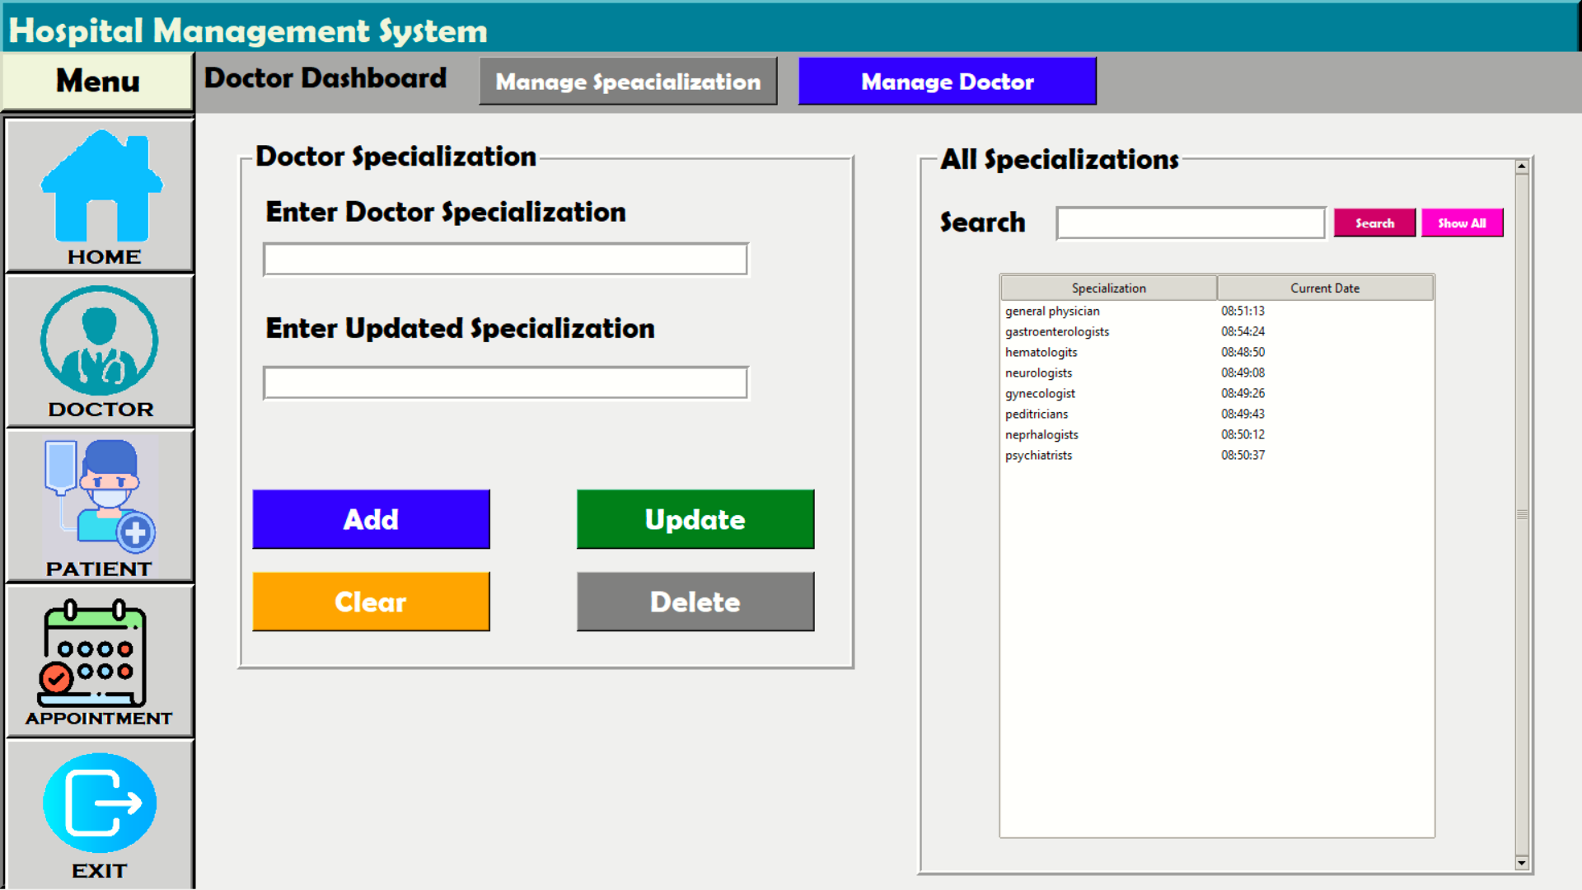
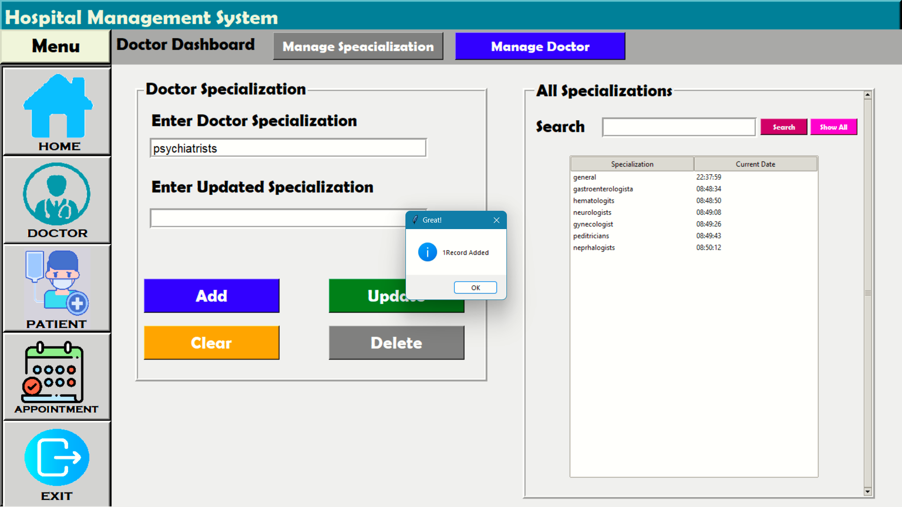
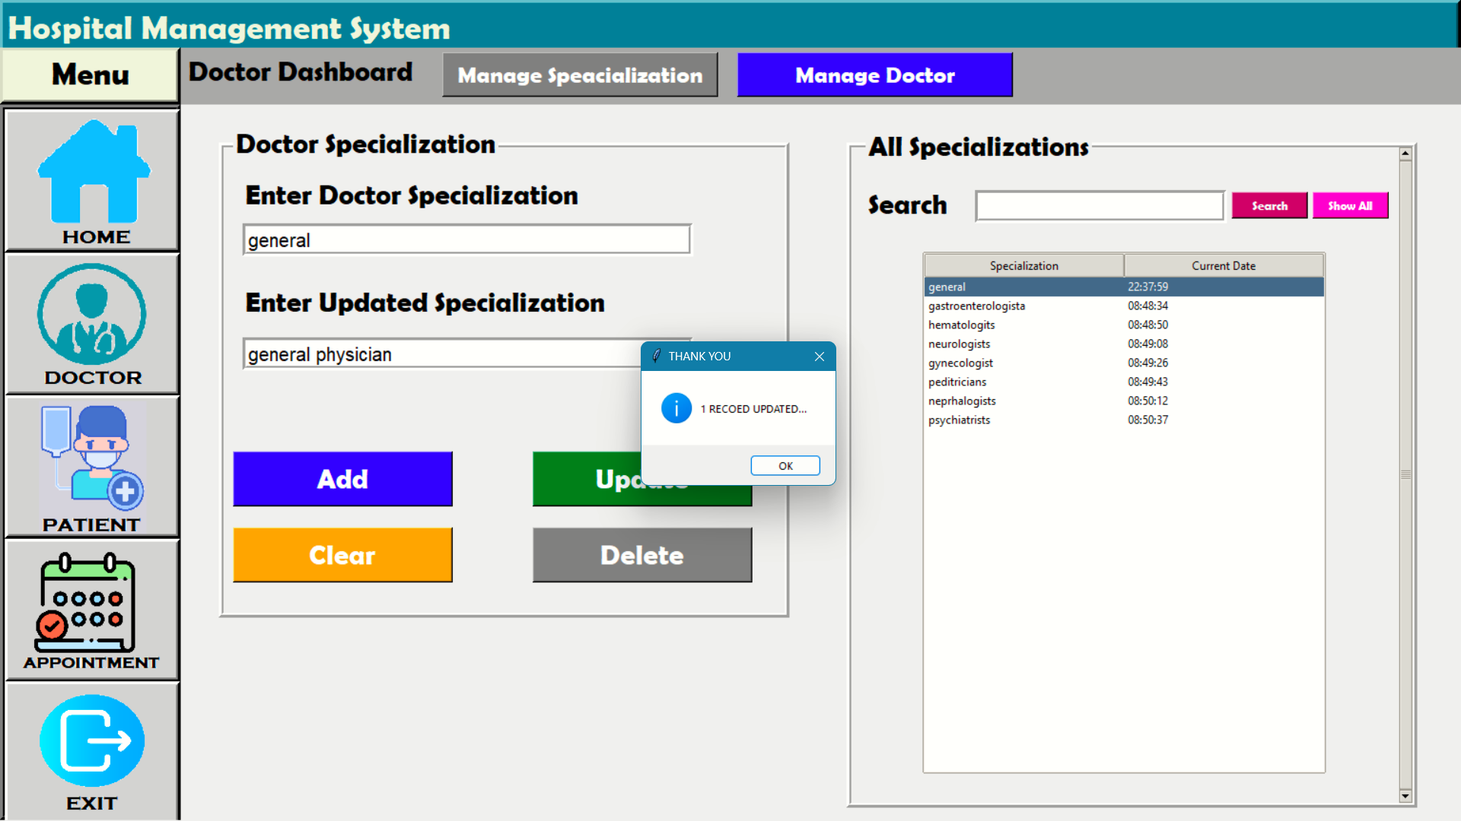
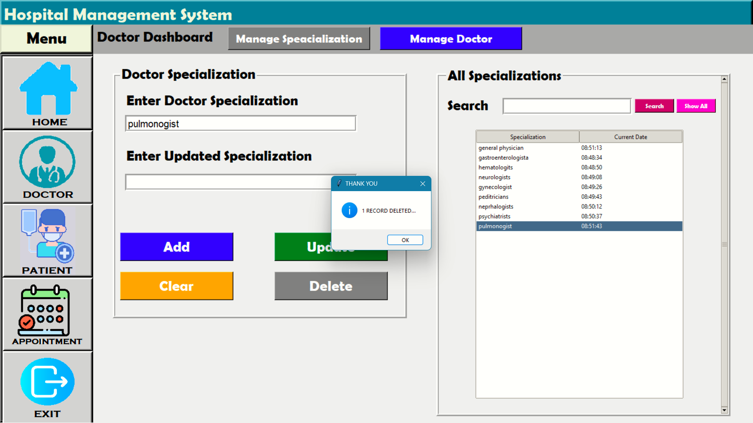
DOCTOR SCREEN

Slide 8
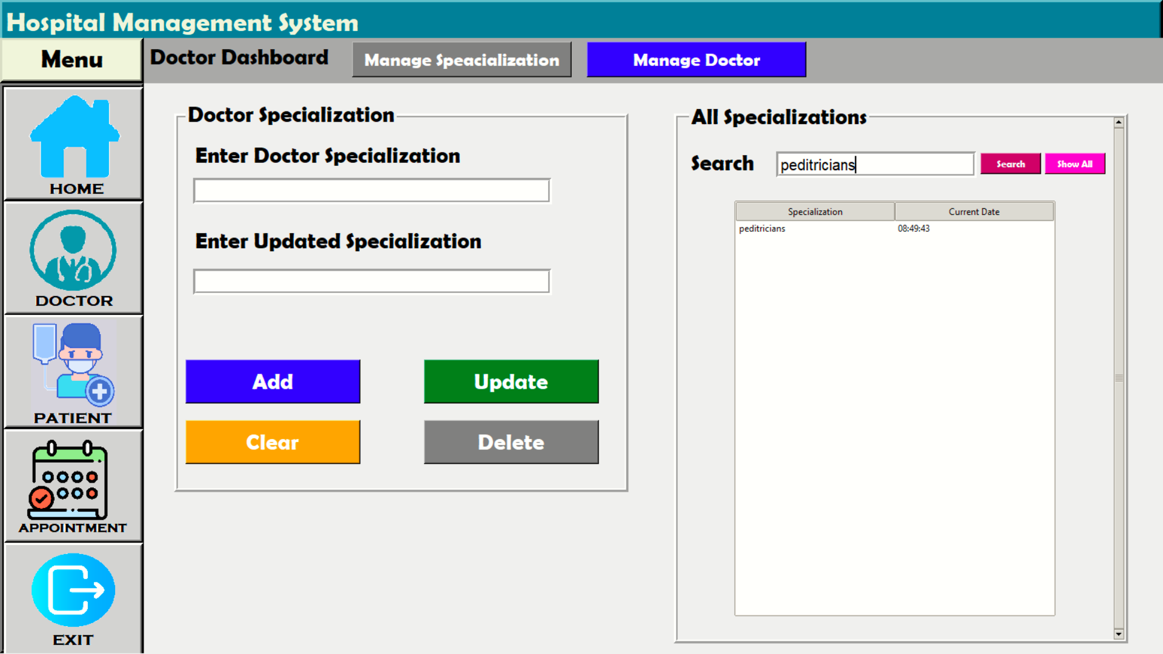

How search works?
Show All

Slide 9
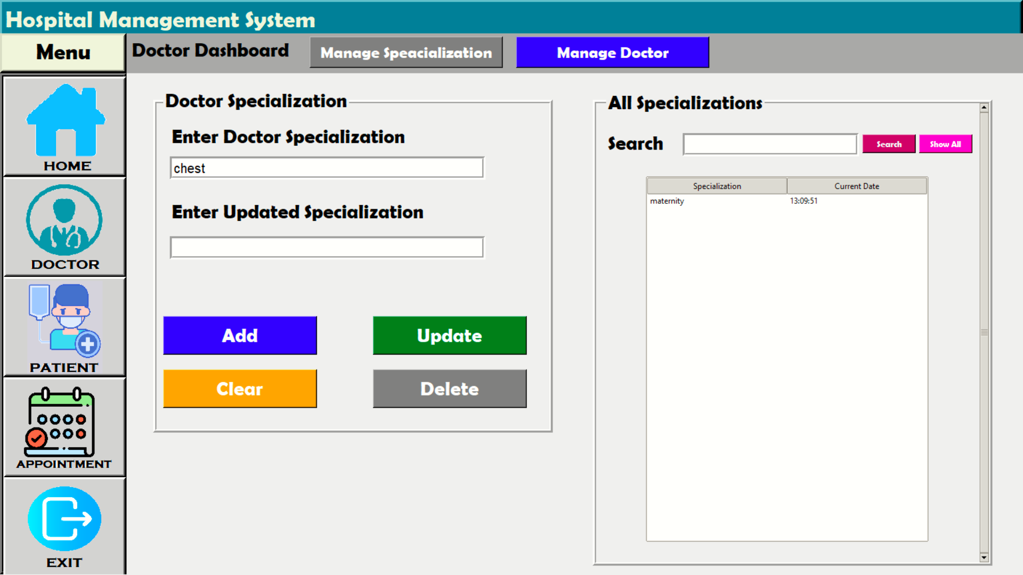
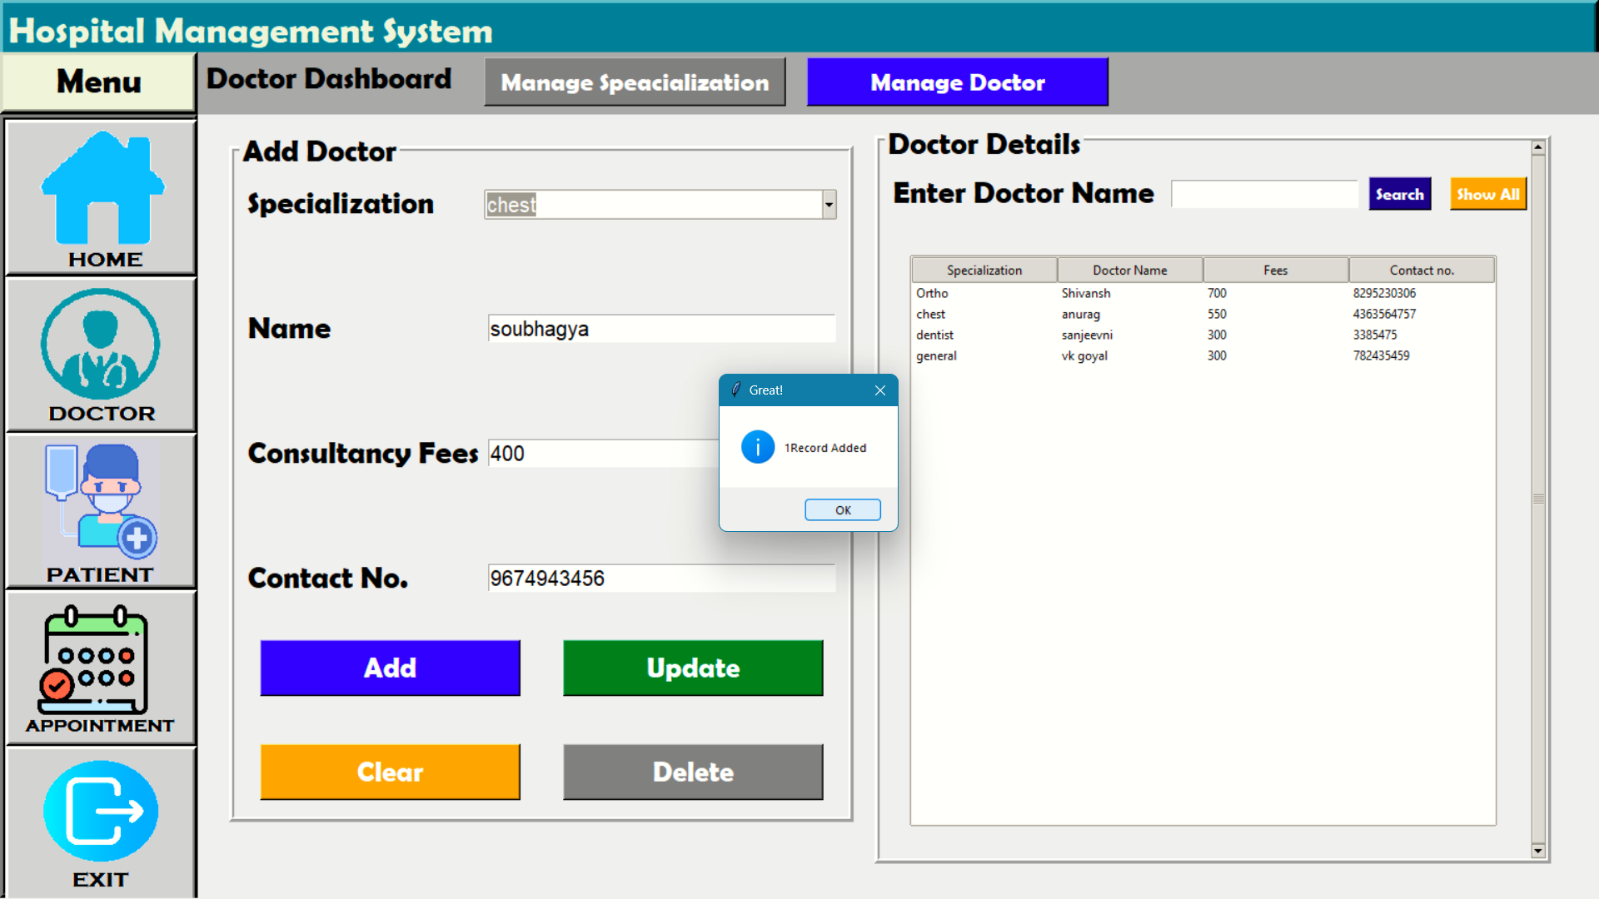

DOCTOR SCREEN

Slide 10
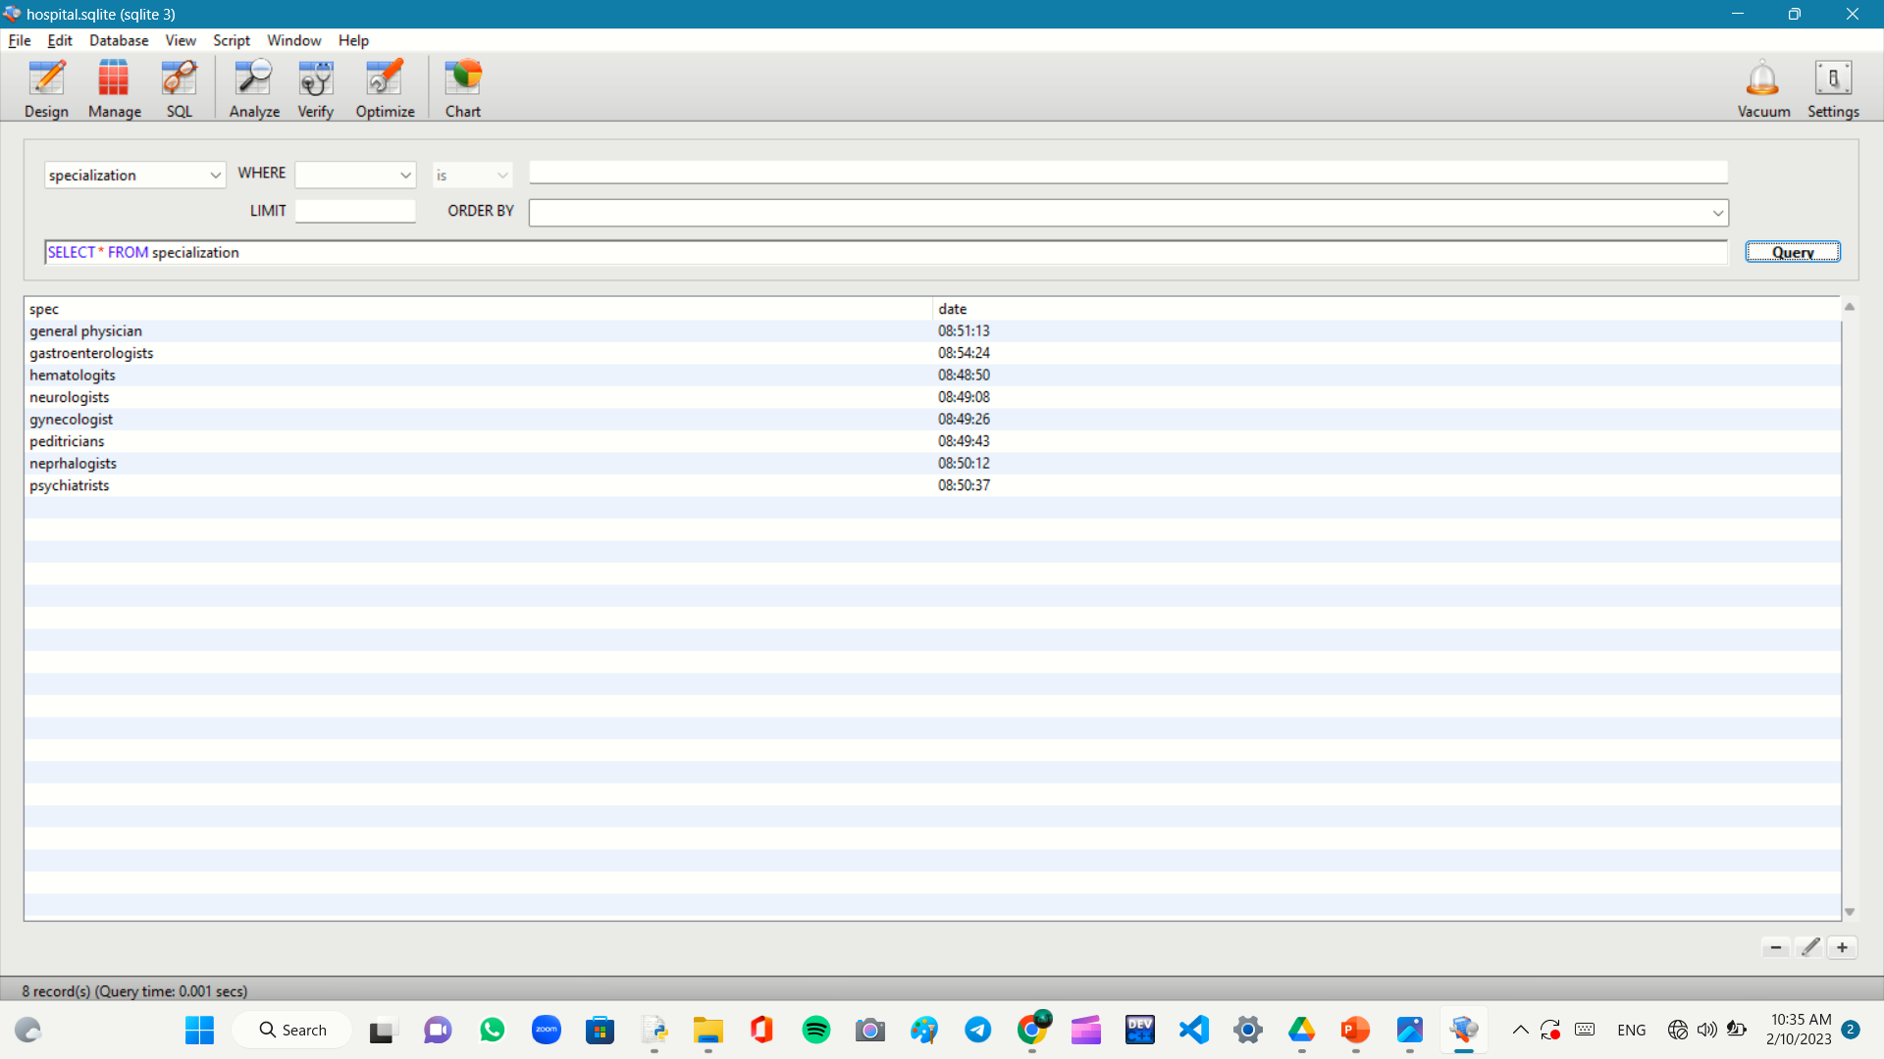
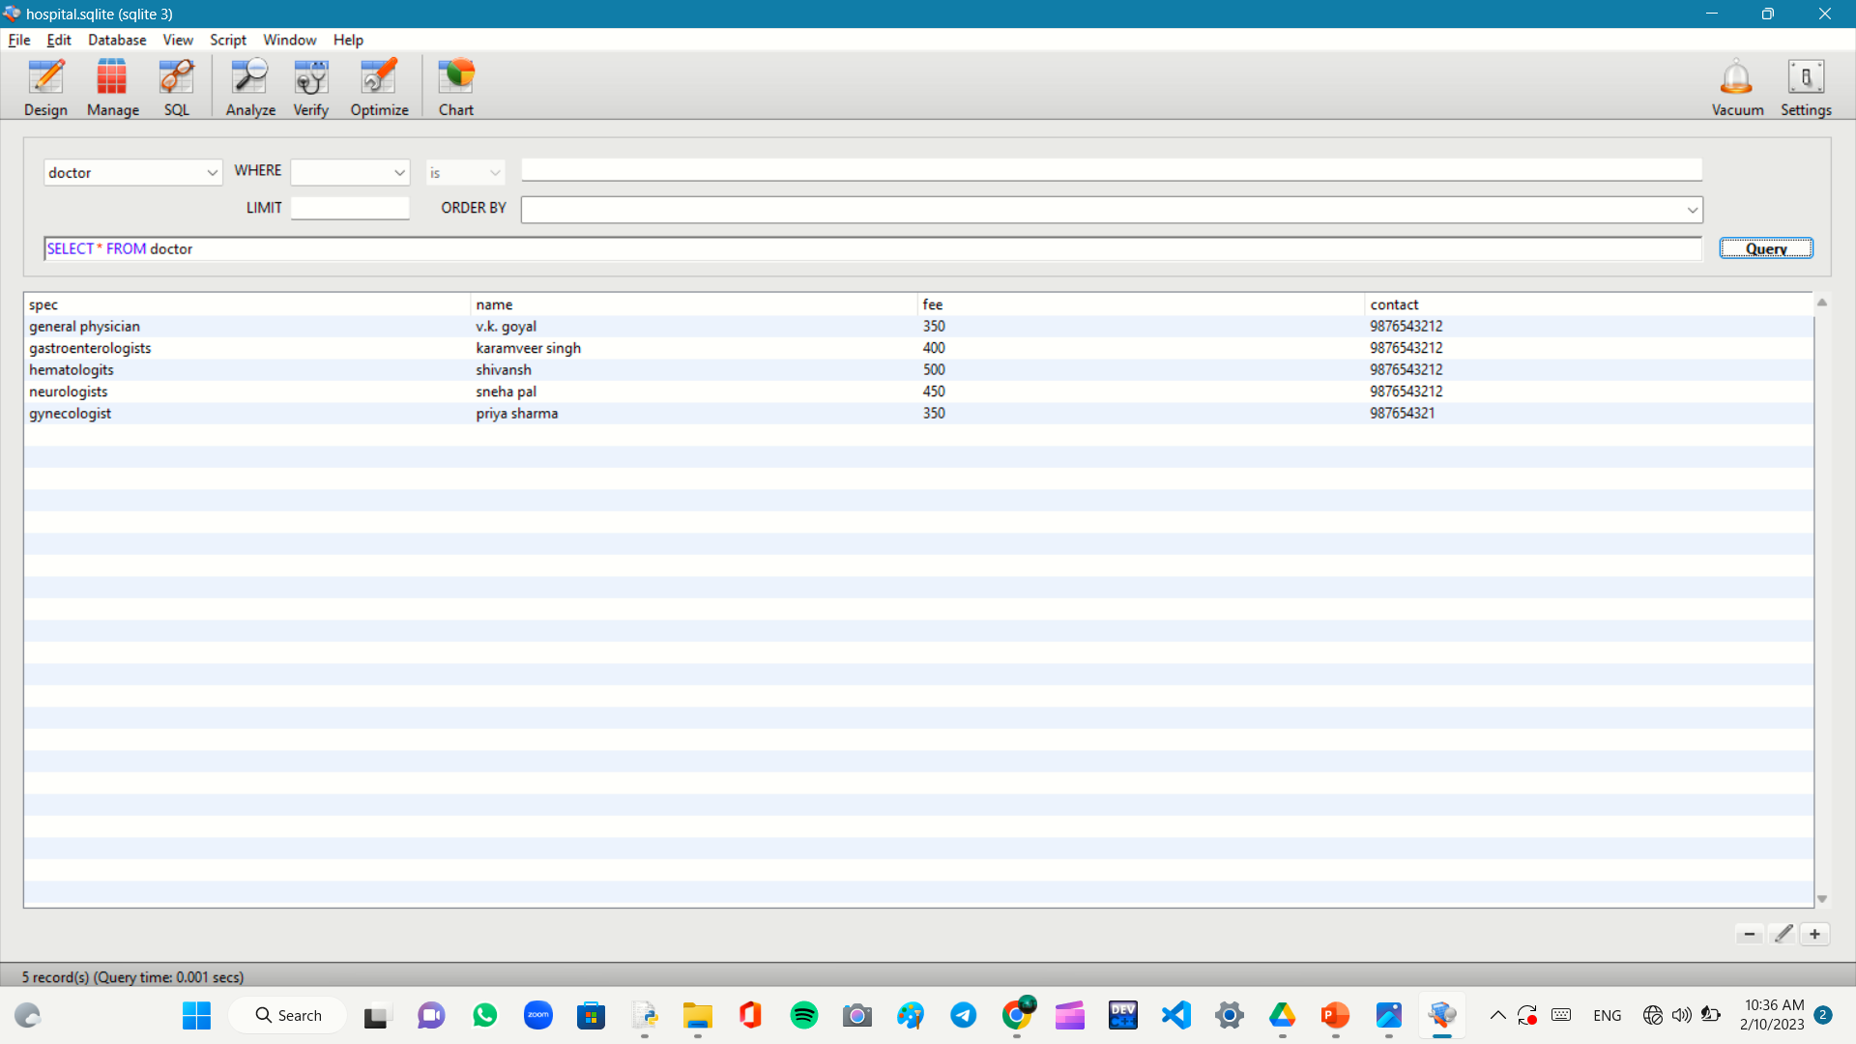
DOCTOR SCREEN BACKEND

Slide 11
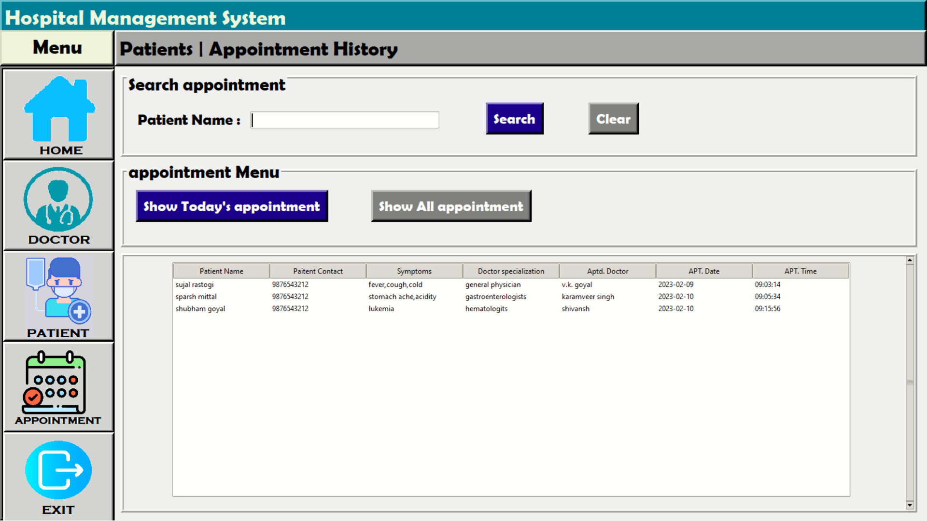

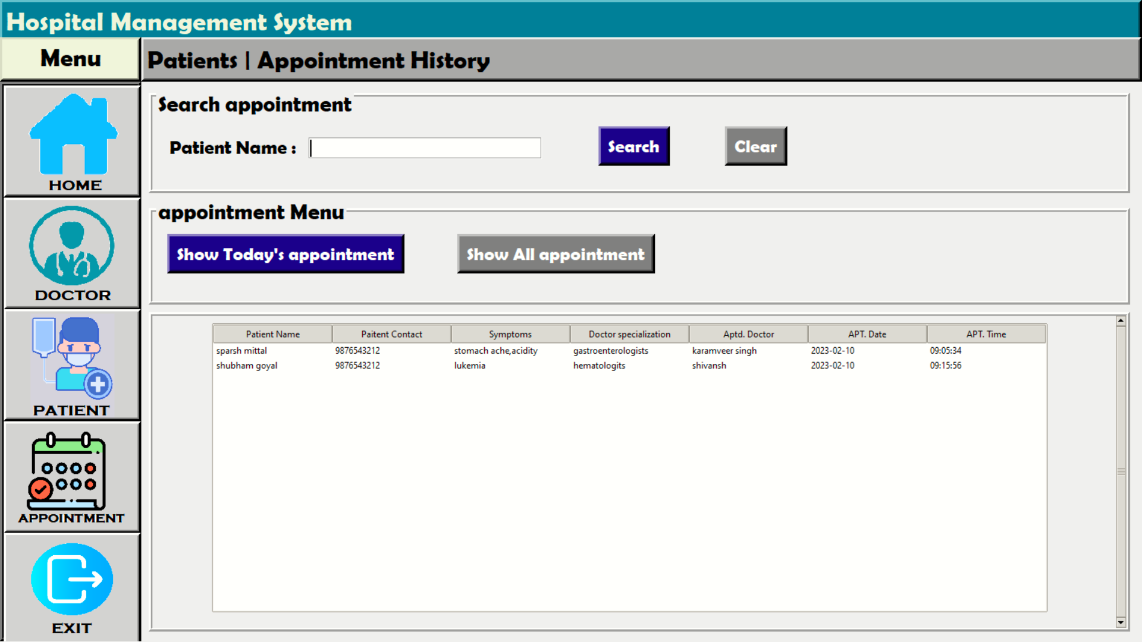
PATIENT SCREEN
Show Today’s Appointment
Show All Appointment

Slide 12
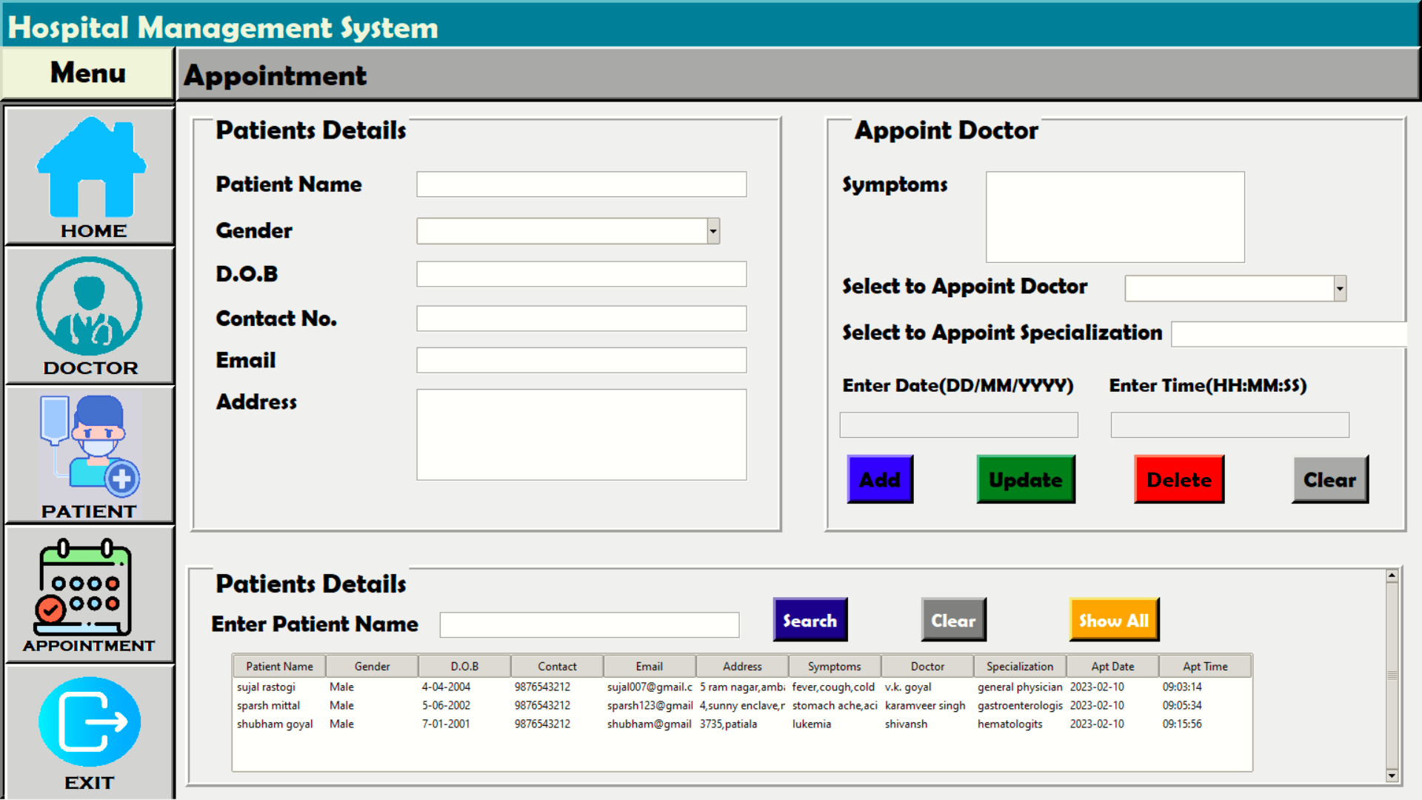
APPOINTMENT SCREEN

Slide 13
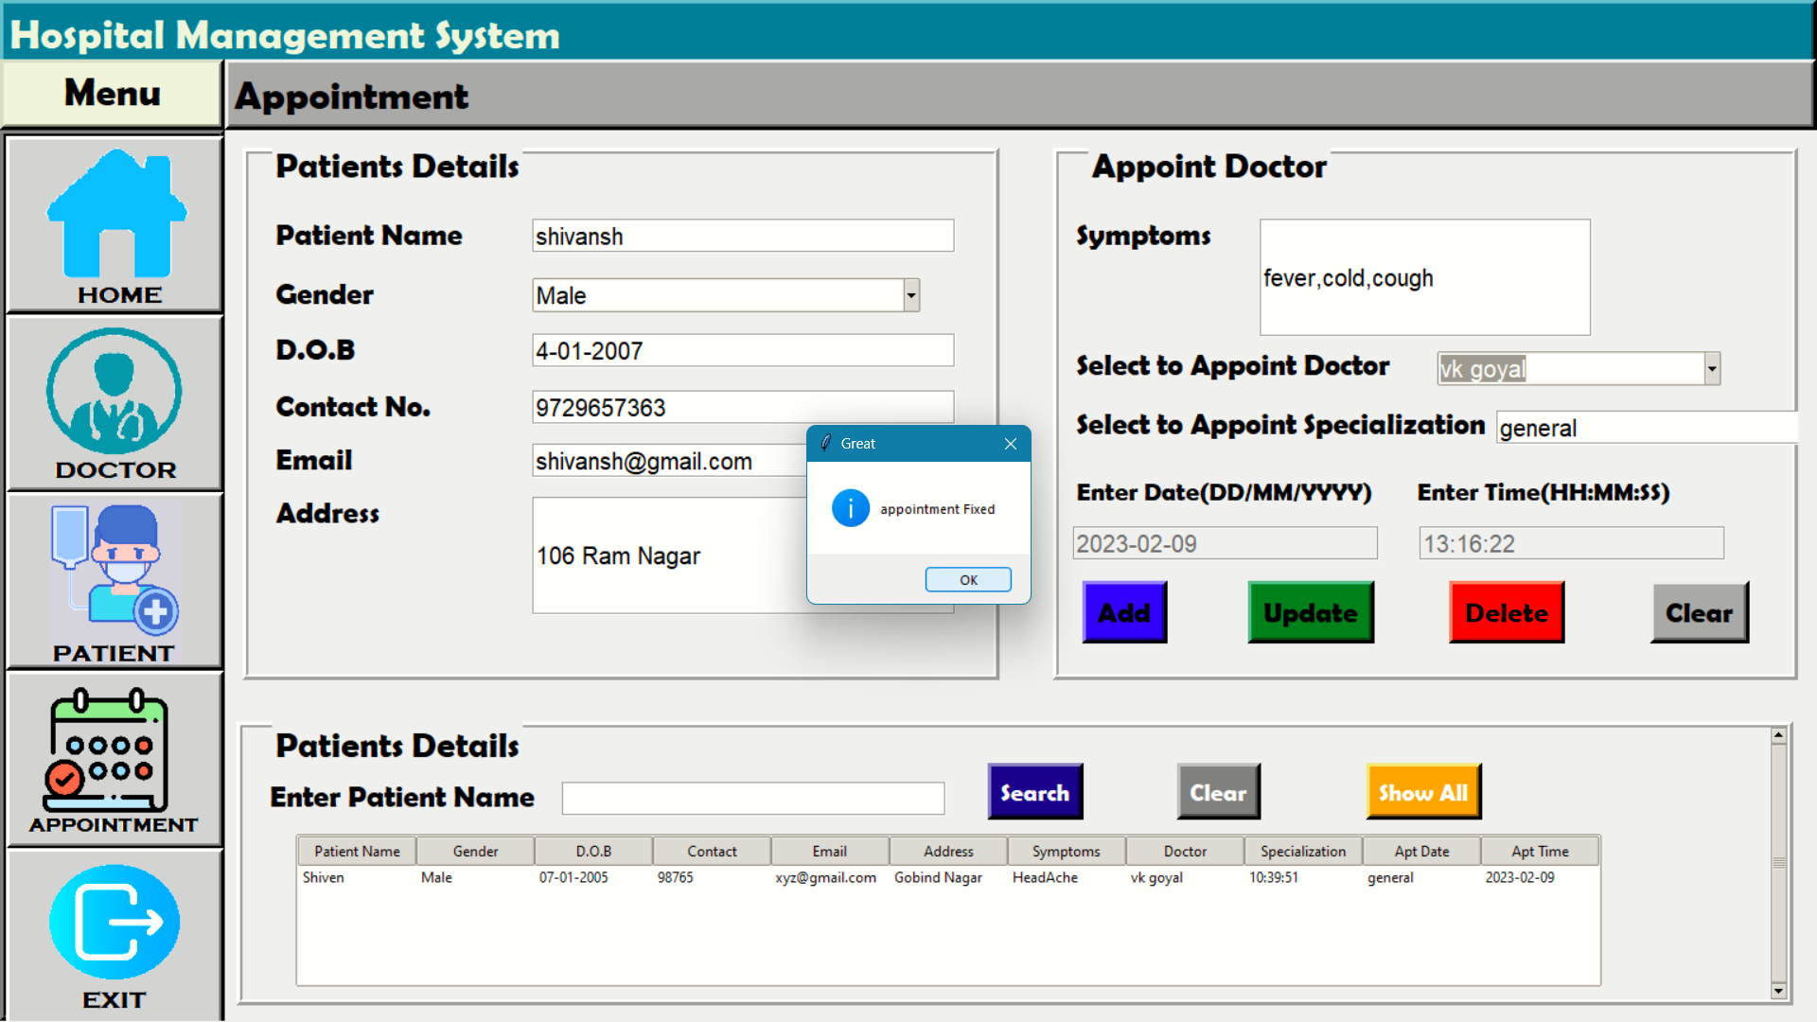
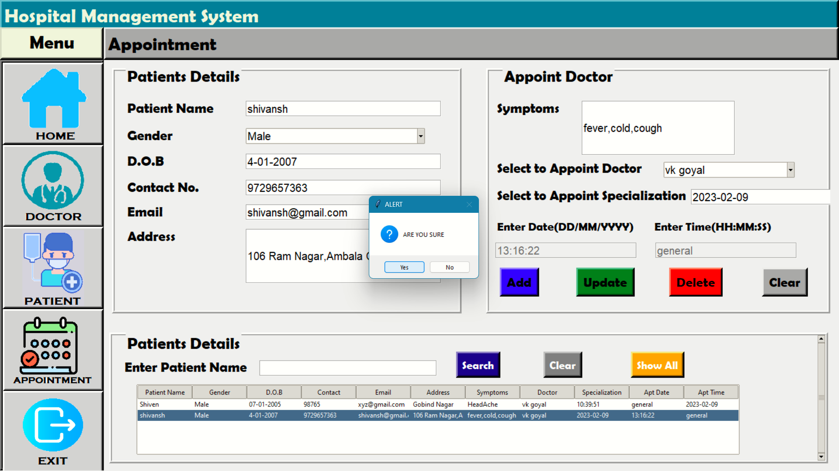
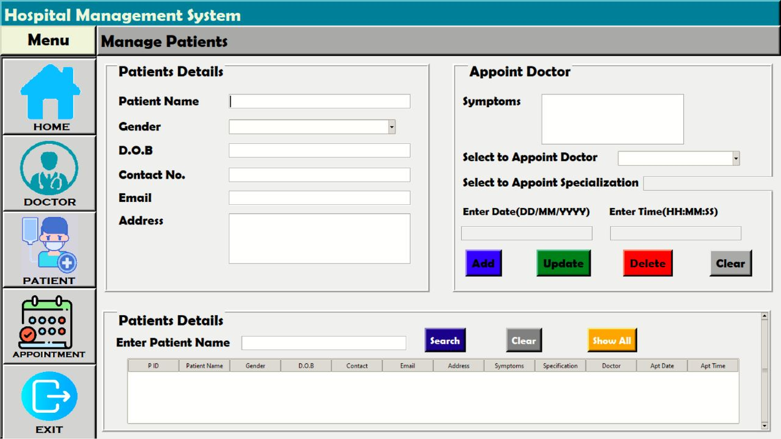

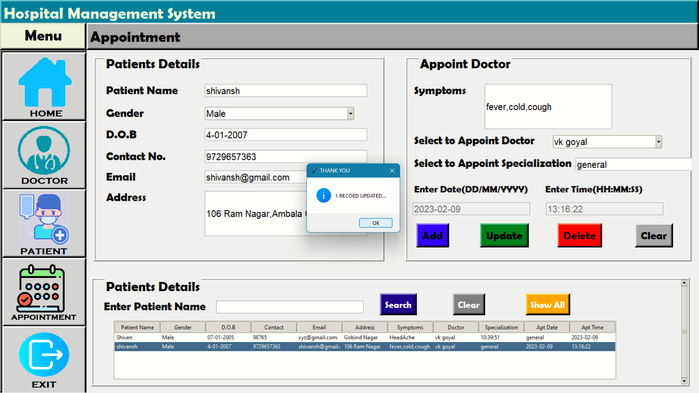
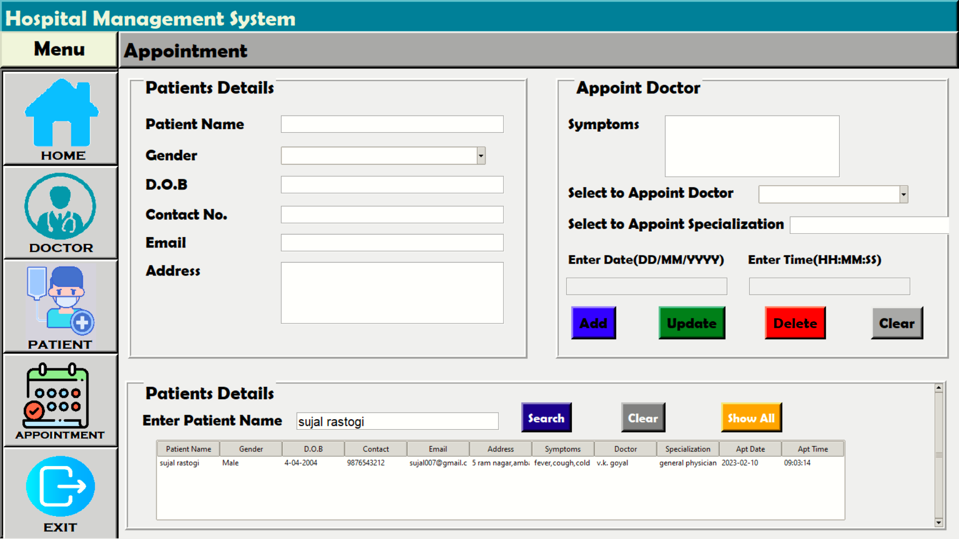
APPOINTMENT SCREEN

Slide 14
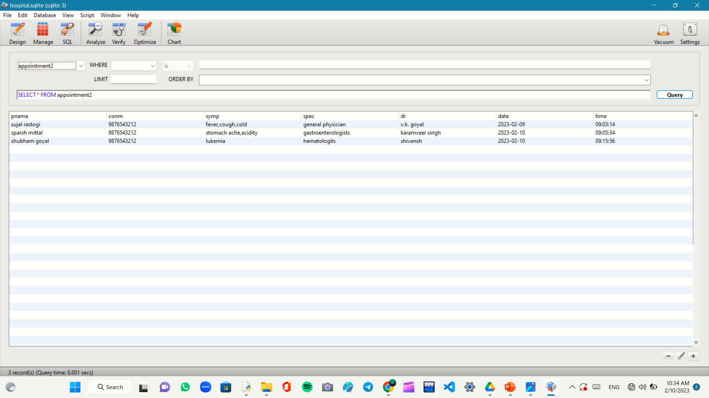
APPOINTMENT SCREEN BACKEND

Slide 15
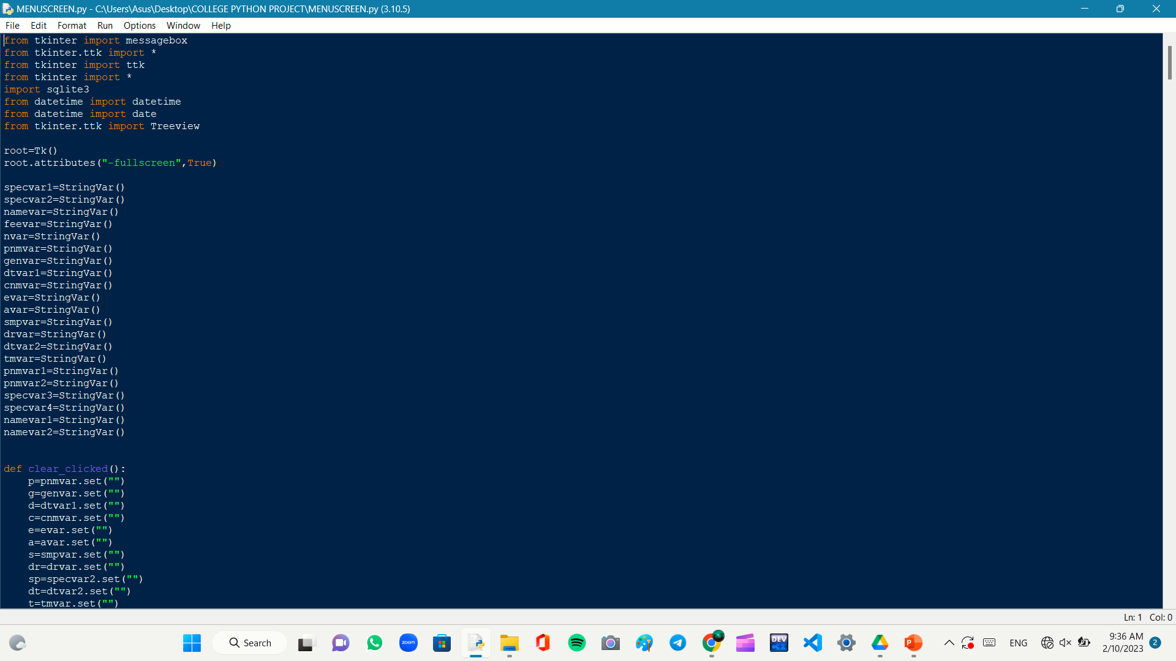
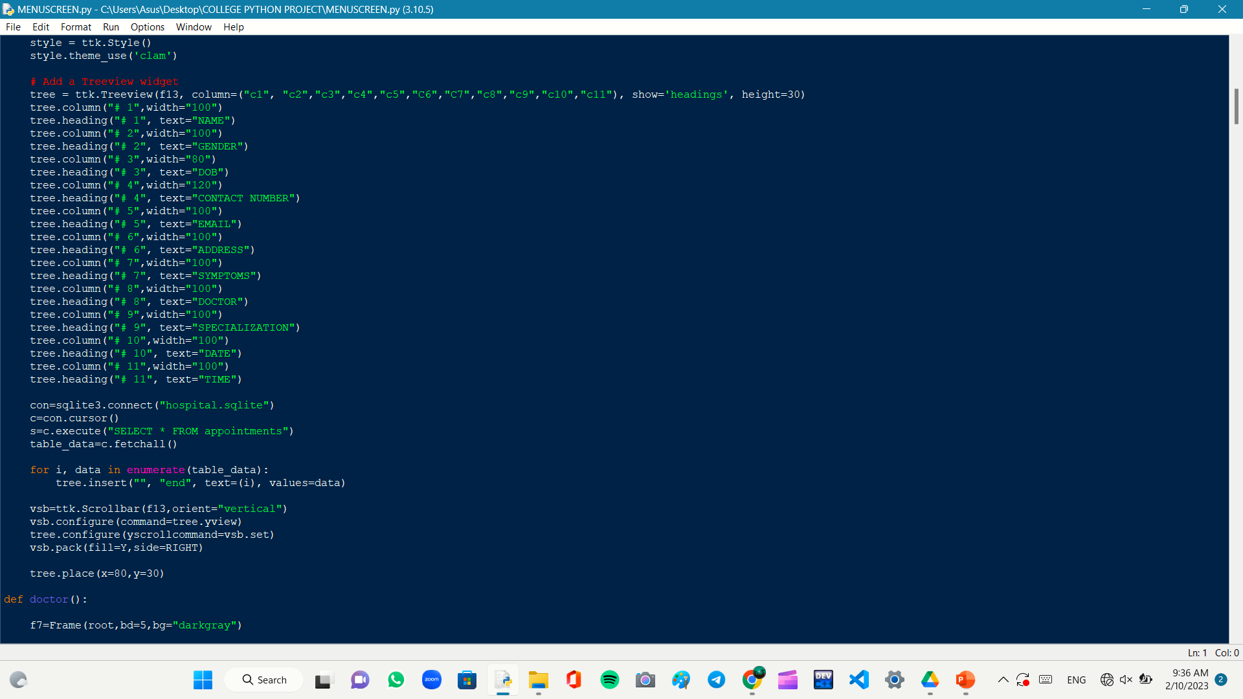
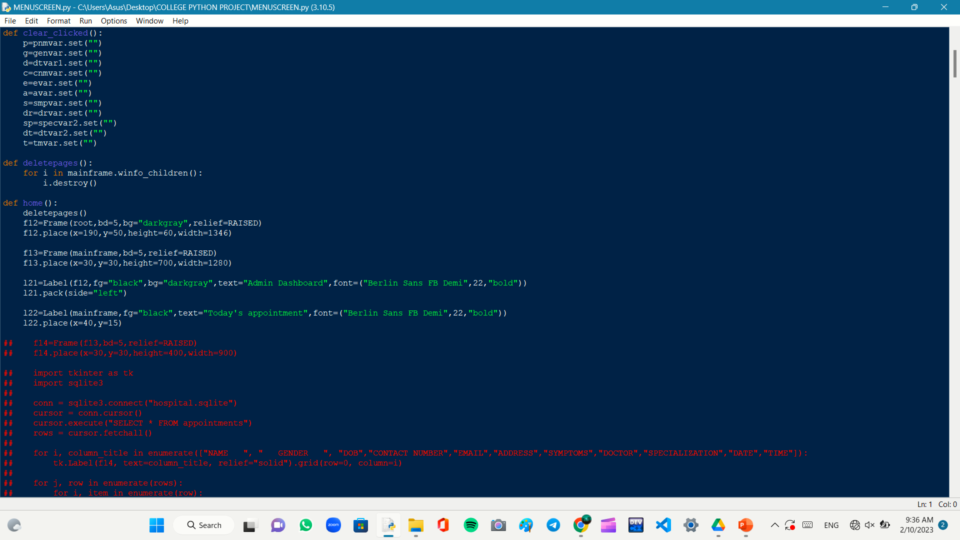
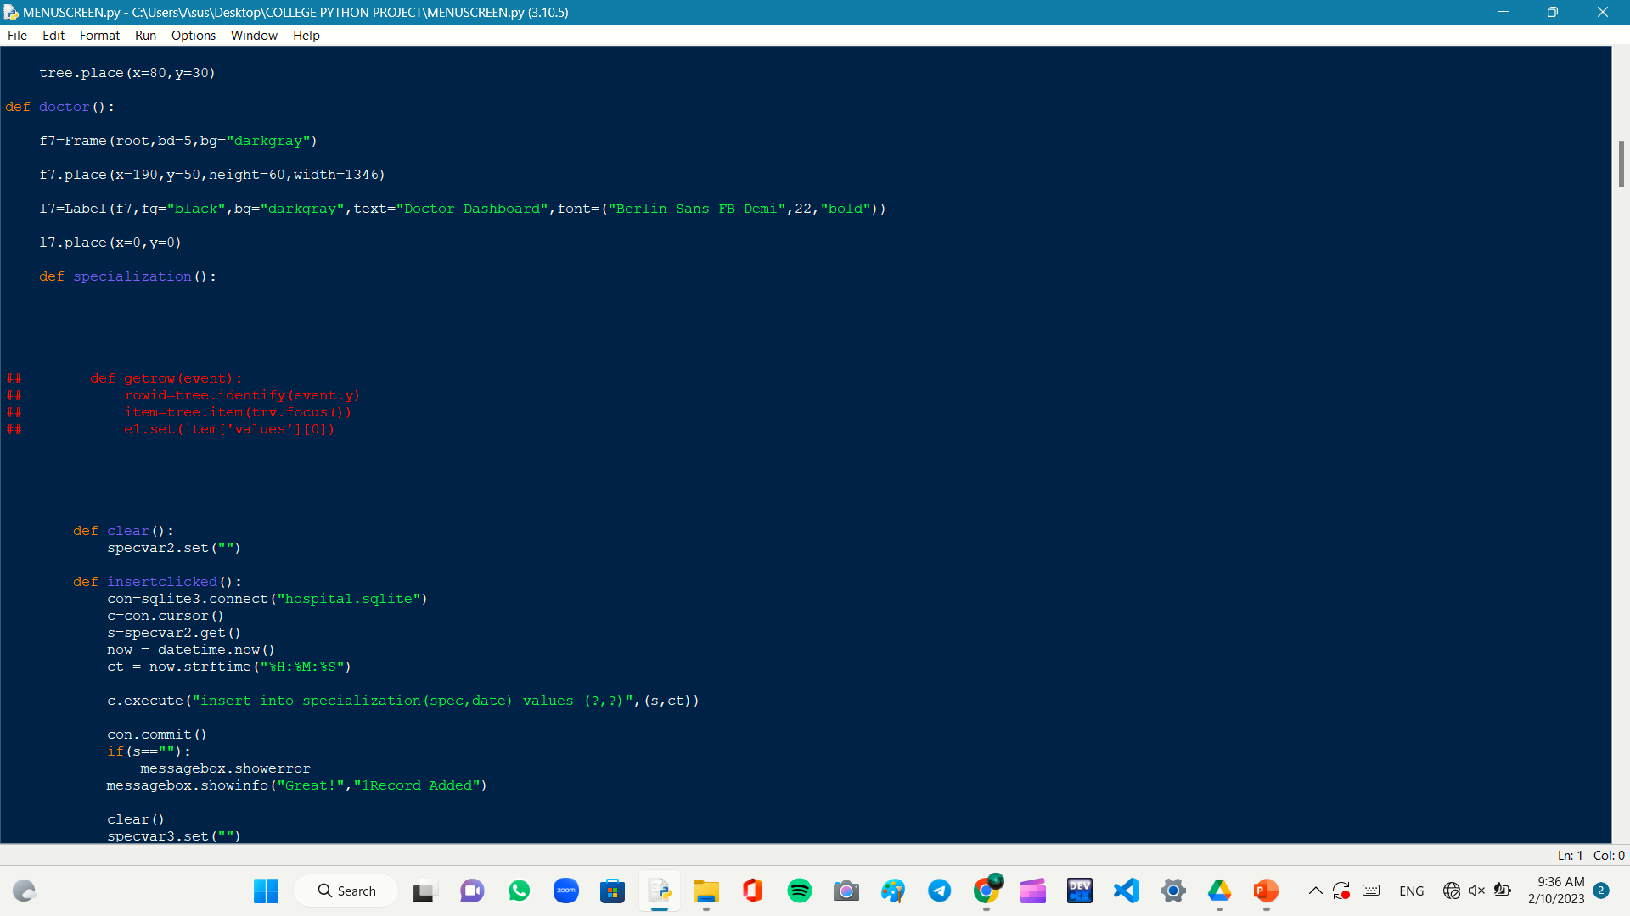
CODE SNIPPETS

Slide 16
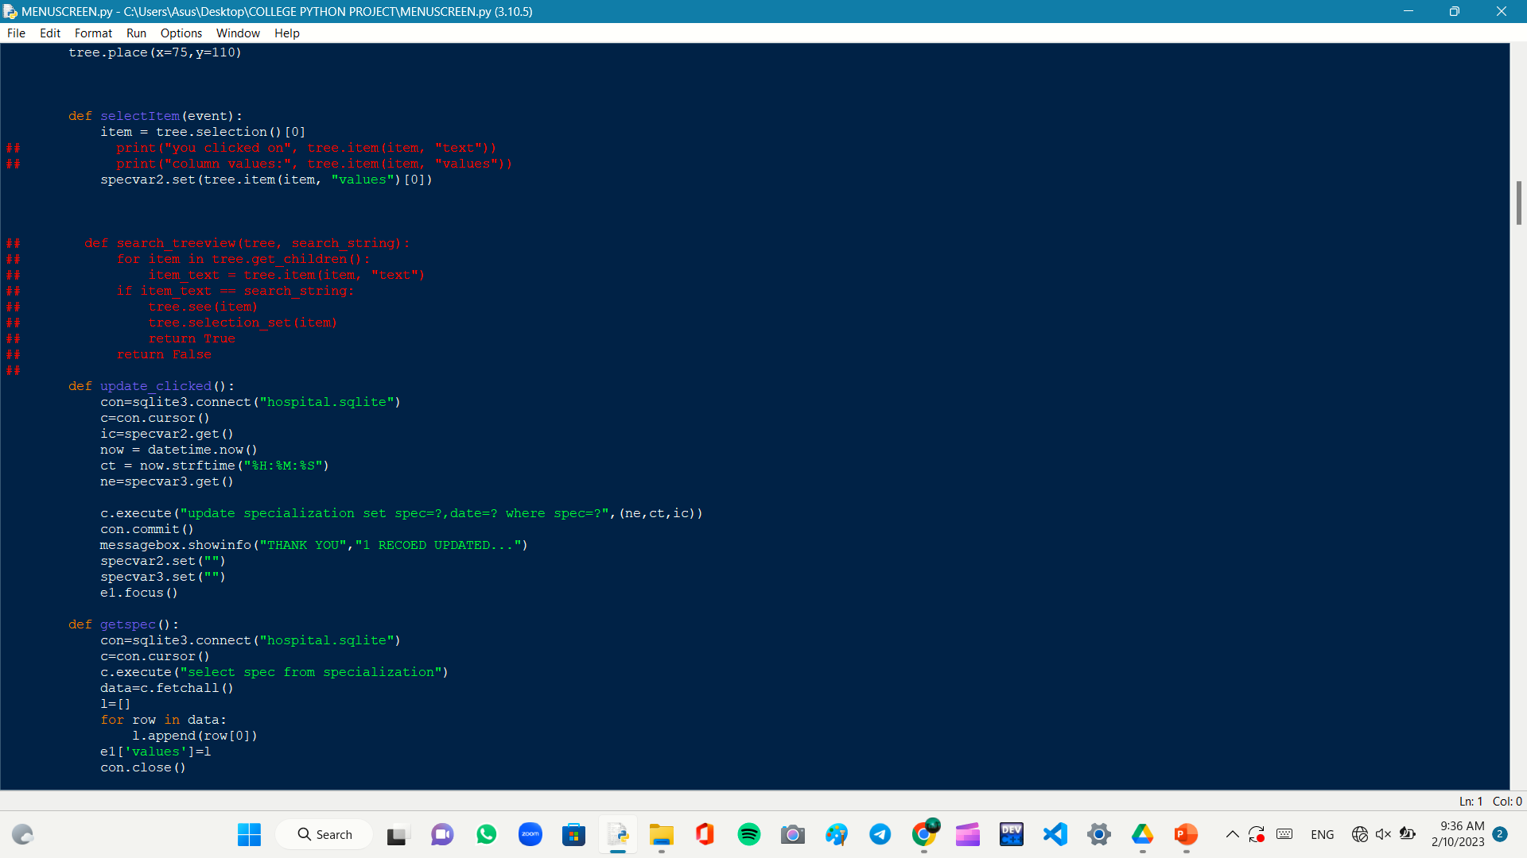
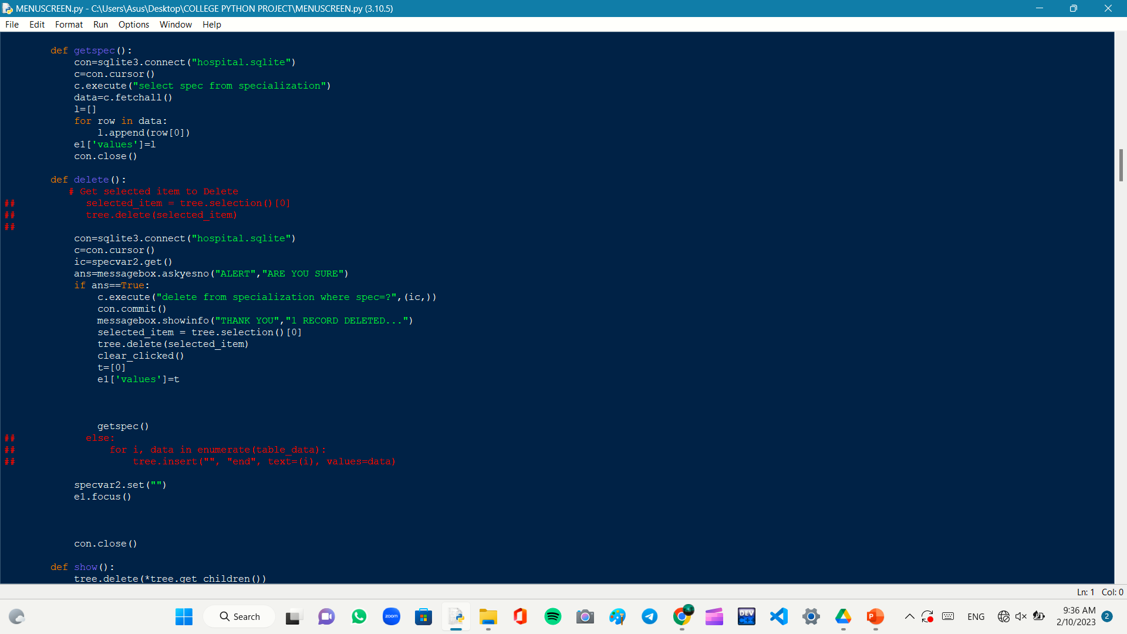
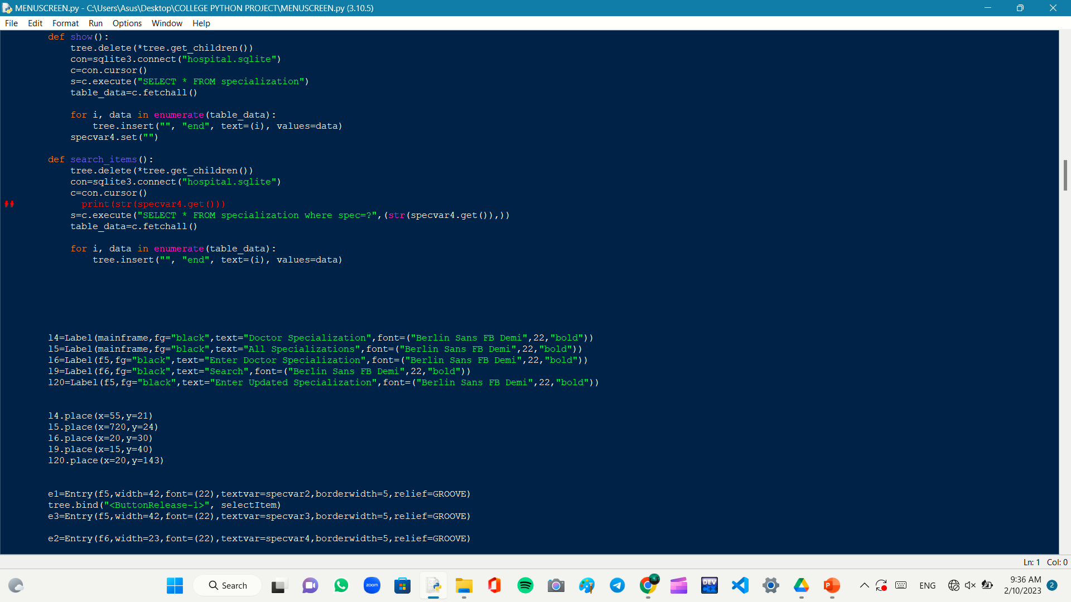
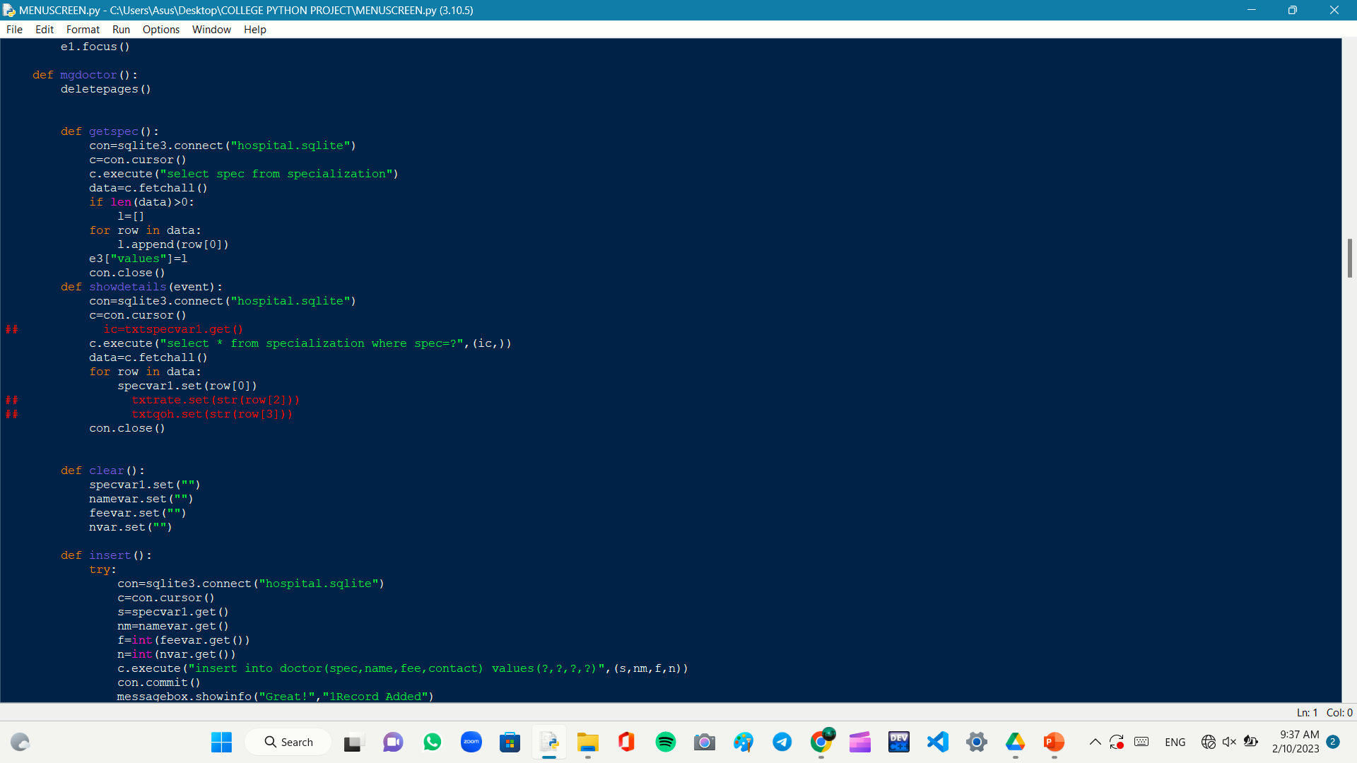
CODE SNIPPETS

Slide 17
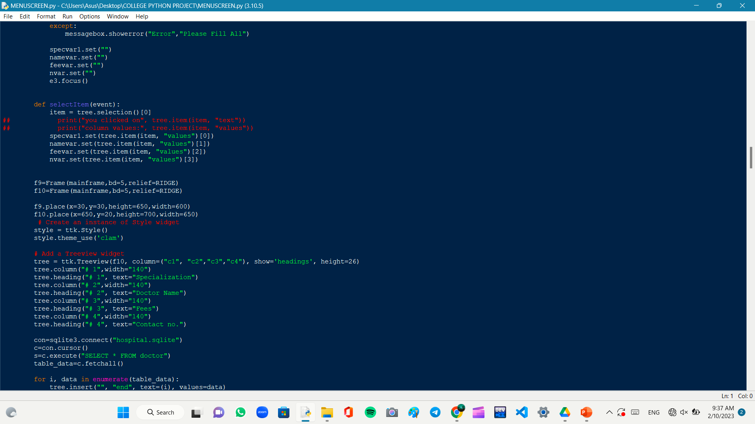
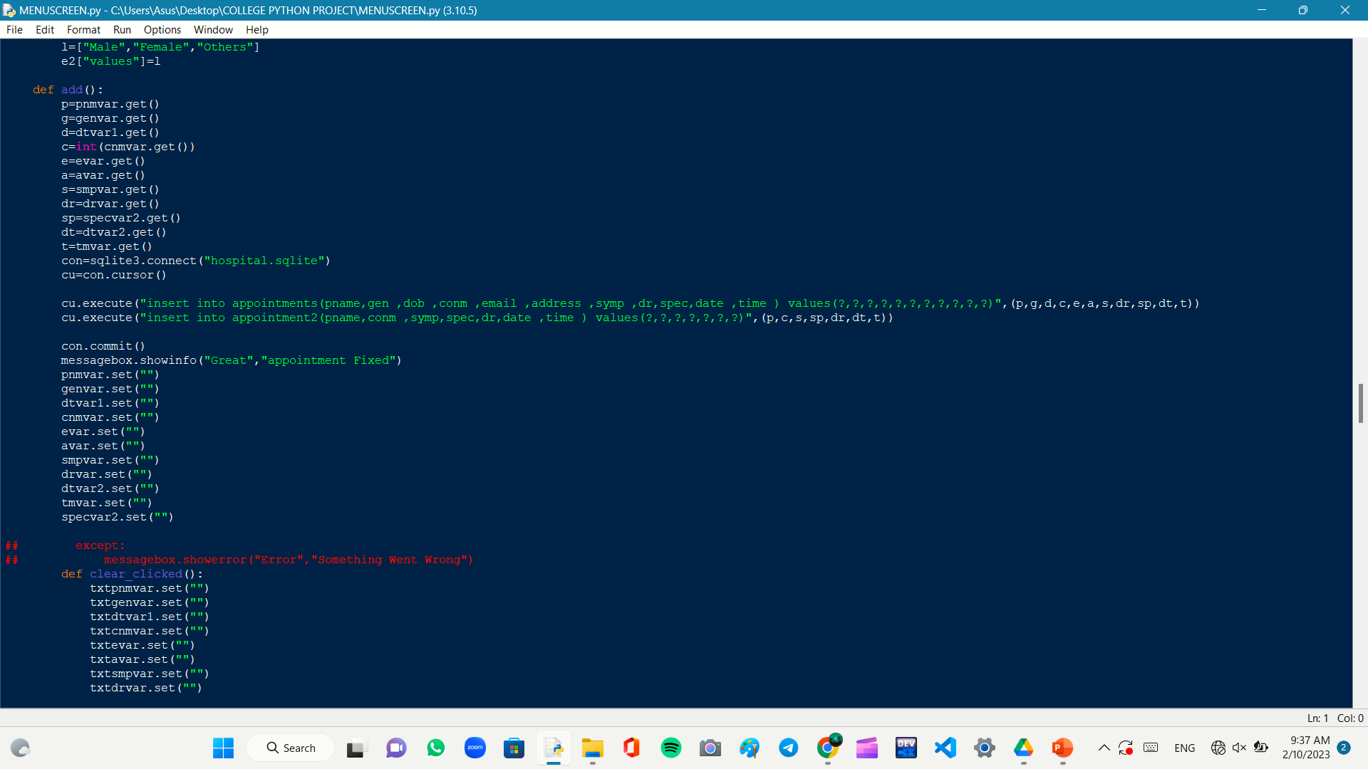
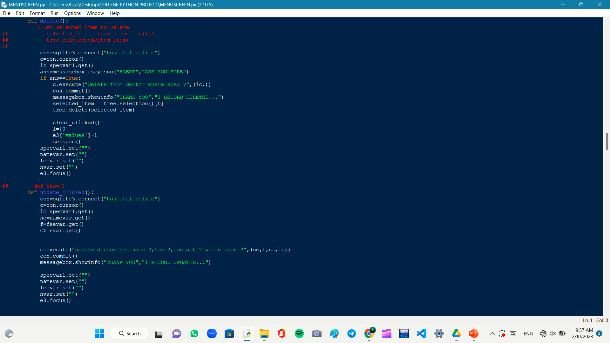
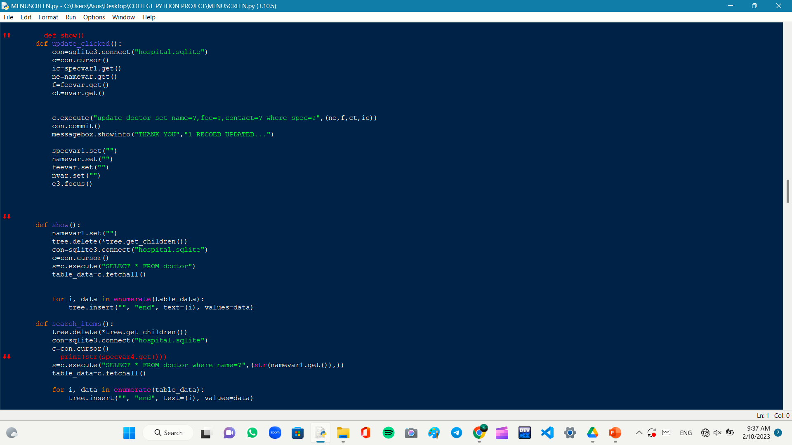
CODE SNIPPETS

Slide 18
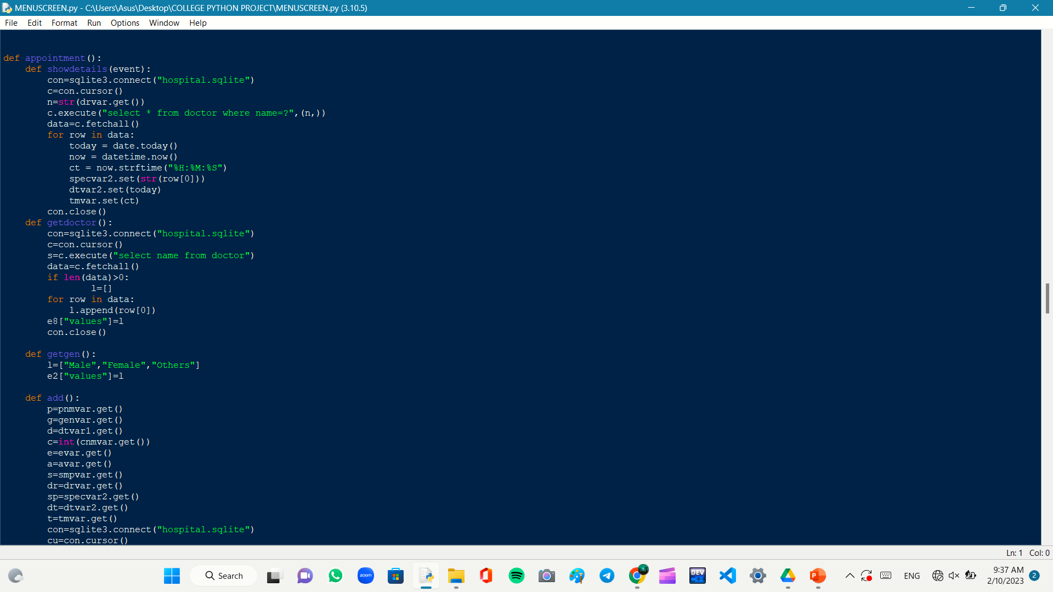
CODE SNIPPETS

Slide 19
FUTURE SCOPE
THIS APPLICATION IS ONLY USED BY THE RECEPTIONIST BUT WE ARE GOING TO MAKE THE SAME THING FOR PATIENTS WHICH CAN BE OPERATED THROUGH WEB .
This application has limited number of sections , we will work to add more sections like pharmacy , surgery etc.
ALSO GOING TO ADD SOME MORE FEATURES FOR EXAMPLE - IF PATIENT IS SAID TO VISIT THE HOSPITAL AFTER SOME GIVEN TIME BOUNDARY THEN THIS WILL AUTOMATICALLY SEND THE EMAIL TO THE PATIENT.

Slide 20
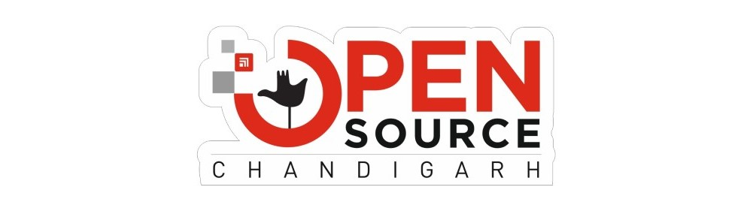
Thanks
An Open Source Chandigarh Initiative

